Slide 1
ICS Lab 10

Slide 2
Agenda
Unit Project 2 follow-up
Unit Project 3 Intro

Slide 3
Unit Project 2 Follow-up

Slide 4

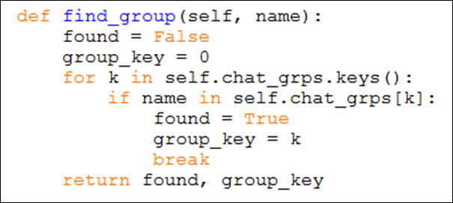
Unit Project 2
Sample Solutions
is_member
a one-liner
find_group
the most important function
the rest functions kind of
depend on this one

Slide 5

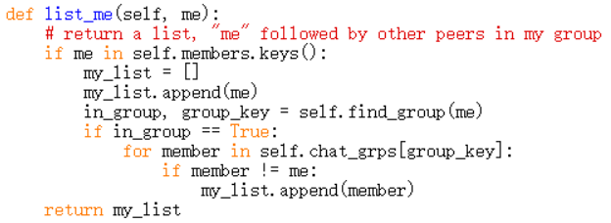
Unit Project 2
Sample Solutions
leave
disconnect
self.members
bookkeeping
list_me
A bit tricky
append yourself first
Avoid doing it again
when cycling through
the list

Slide 6
Unit Project 2
Sample Solutions
connect + disconnect
a lot of bookkeeping
Enforcing consistency between self.members and self.chat_grps
see next slide for sample solution

Slide 7
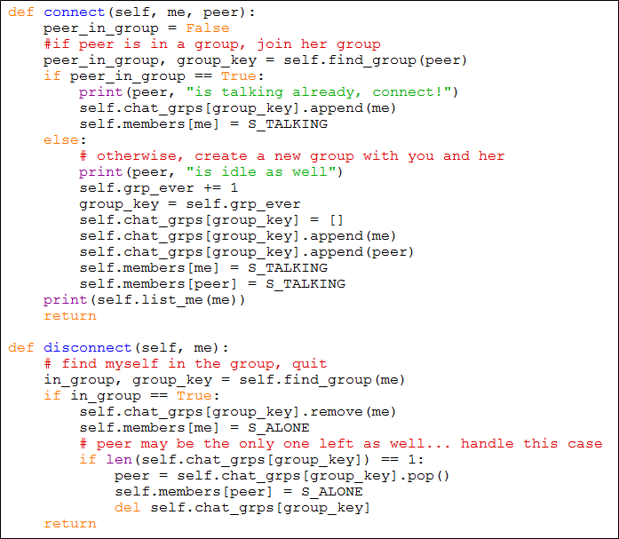
Unit Project 2
Sample Solutions
connect + disconnect
cont.

Slide 8
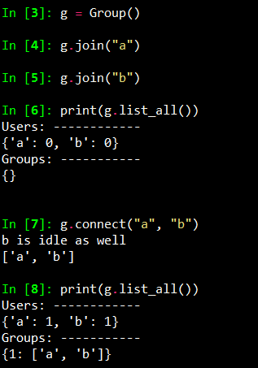
Unit Project 2
Sample output:

Slide 9
Agenda
Unit Project 2 follow-up
Unit Project 3 Intro

Slide 10
Unit Project 3 Intro

Slide 11
Socket: the framework
Client_1
Client_2
…...
Client_n
sockets
…...
They look like file descriptors, working with read(), write() commands.
server
Sockets: allowing communication between two different processes on the same or different machines.

Slide 12
More detail about sockets
connect()
accept()
Client_1_socket
socket_for client_1
Client 1
receive()/
send()
server-socket
server
Notes:
One file for the server another for the client.
If there are n clients, we need to run n+1 files bc the extra one is for the server.
Server-socket is a class

Slide 13
More detail about sockets
connect()
accept()
Client_1_socket
socket_for client_1
Client 1
receive()/
send()
server-socket
server
receive()/
send()
Client_2_socket
socket_for client_2
Client 2
accept()
connect()

Slide 14
Communication via the Socket:
server
Operations on client side:
Initialization
setting up the socket
connecting to the server
login
logout
and others.
Need a few steps on both sides
socket()
client
bind()
socket()
listen()
connect()
accept()
send()/
receive()
receive()/
send()
close()
close()
An example
Notes:
Bind(): every communication only using one port. 就像我在和a打电话，b再打给我我就在占线

Slide 15
Designing the steps: Protocol code
Off line
“c Joyce” or Joyce issues “c Wen”
“q”
“Wen”
logged in
chatting
“bye” or Joyce says “bye” and Wen is the only other peer
“Time”, “who”, “p 3”,
“? love”
Notes:
‘P 3’ returns the point
‘?love’ searches key words in UP1
‘c’ means connect

Slide 16
Unit Project 3
Complete 2 files:
client_state_machine.py
chat_server.py
find all the“pass” and complete them
Tips:
Read the document first, understand the whole process
Download all files from NYU Class including UP1, UP2 solutions

Slide 17
Unit Project 3
Important
CHAT_IP:
in chat_utils.py

Slide 18
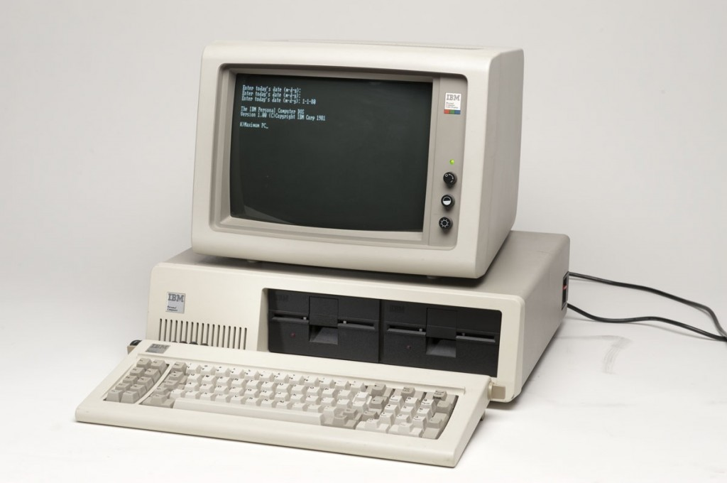
Terminal/Command Quick Start
All computers nowadays have GUIs
GUI = Graphical User Interface
But not so in early days
Terminal/CMD was the only way to manage your file system
The chat system is designed to handle multiple clients
Hence we need multiple sockets
Python’s shell does not support such purpose
But Terminal/CMD does

Slide 19
Terminal/Command Quick Start
shell programming & scripting is a HUGE field
but we only focus on the parts related to our chat system
and of course UP3
cd the “change directory” command
cd [your_next_layer_destination]
“cd ..” brings you back to previous layer/directory
“cd ~”/ “cd ” brings you to your home directory
Use “tab” for autocompletion
dir/ls
shows you a list of files at current layer

Slide 20
Terminal/Command Quick Start
python3 (for Python 3)
enters the Python console mode
also shows you the current Python version in Terminal/CMD
you can change the Python version in system PATH
python3 [your_file_name] (for Python 3)
will execute a given file using Python
Ctrl + C/ Apple Button + C
breaks script execution
in case you need to escape from an infinite loop etc.

Slide 21
Sample commands:
Run server and client code:
cd /Users/ecspublic/Documents/git/ICS_chat_student
python chat_server.py # run server code, bring up server
python chat_cmdl_client.py # one client
ctrl + C # stop running python file

Slide 22
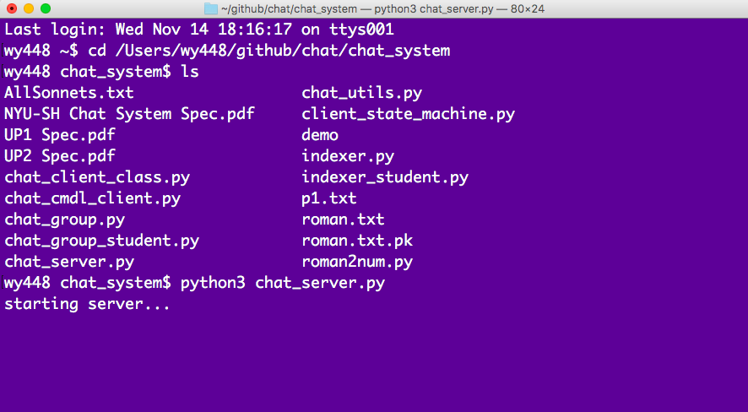
Run and test with the terminal
Change the directory to the folder of up3
python3 chat_server.py

Slide 23
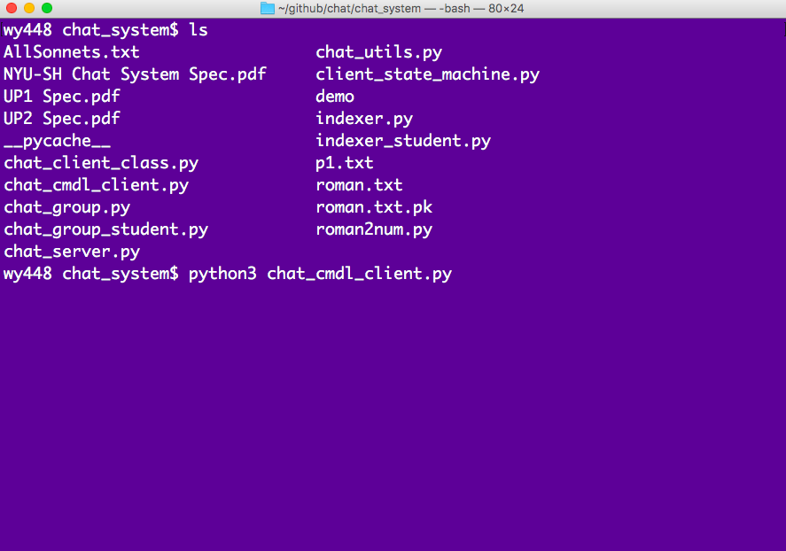
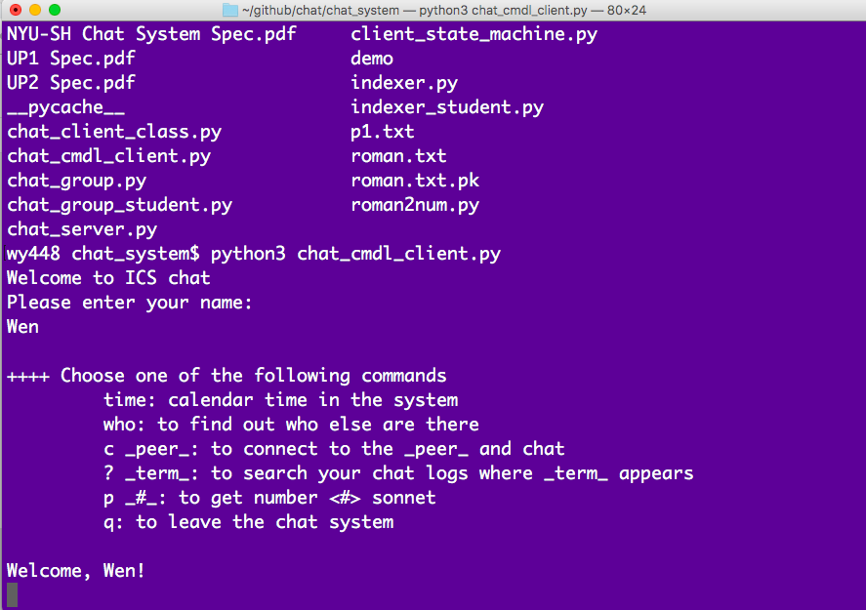
Open another terminal,
Change to the same directory
python3 chat_client.py
Now, you can test your code :)

